Slide 1



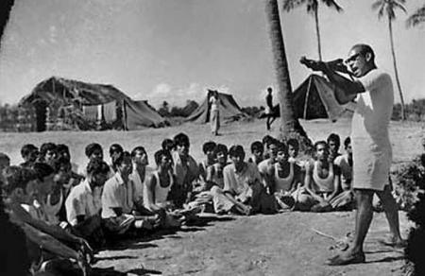
The role of students in Liberation War

Slide 2

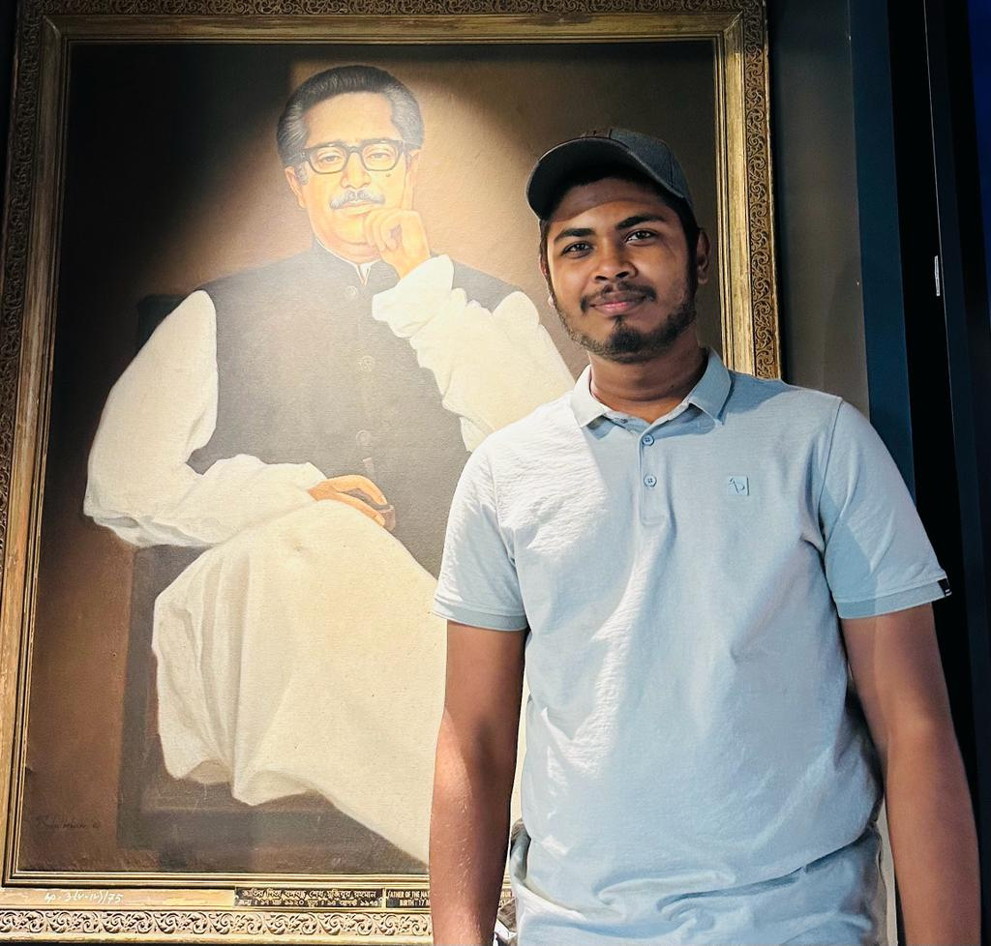
Presented by
Awadhe Hossain
ID:0112330487

Slide 3



When our liberation War was start?
In 1971
In 1947

Slide 4
Actually
The seeds of independence were essentially sown
In 1952

Slide 5
Many movement
are occurred (1952-1971)
Language movement of 1952
Student movement of 1962
Mass uprising of 1969
Liberation War of 1971

Slide 6
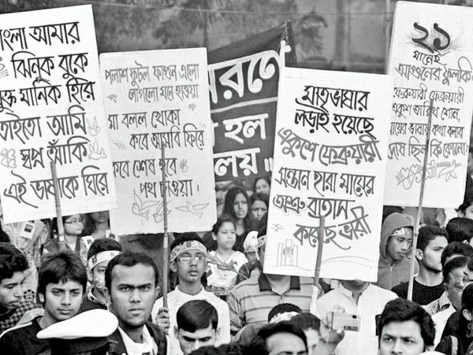
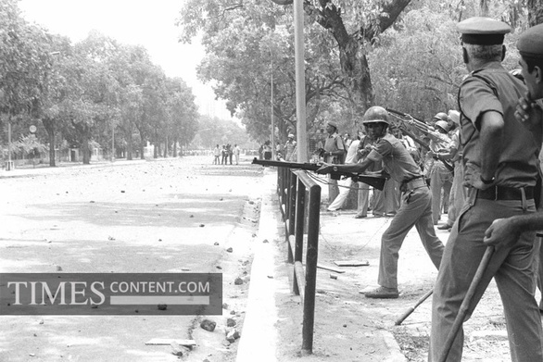
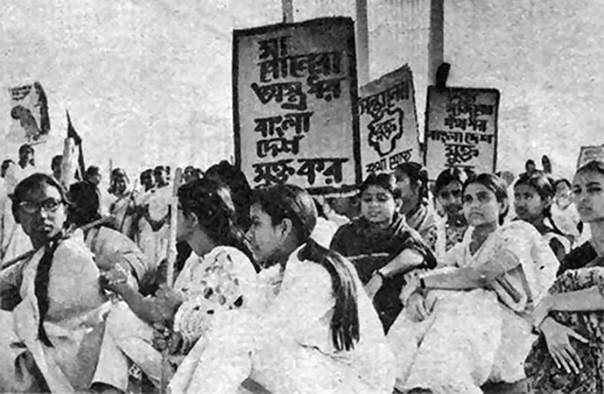
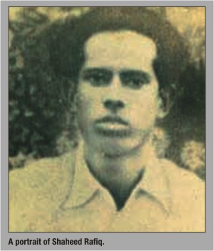
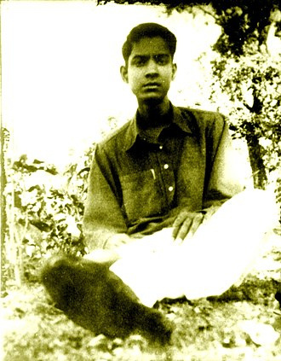
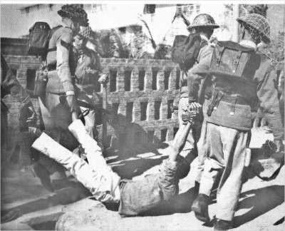
1952
Language Movement

Slide 7
1952
Language Movement

Slide 8
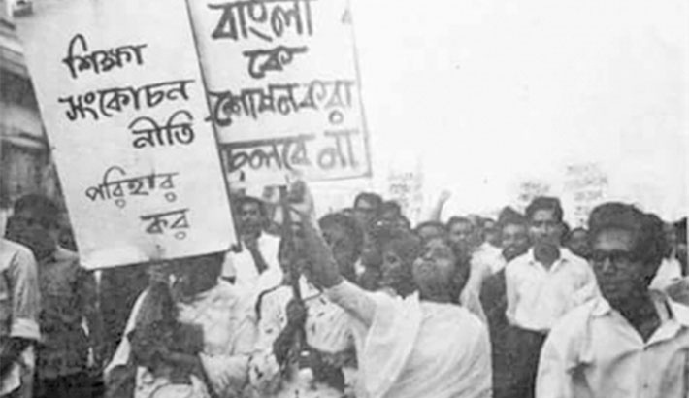
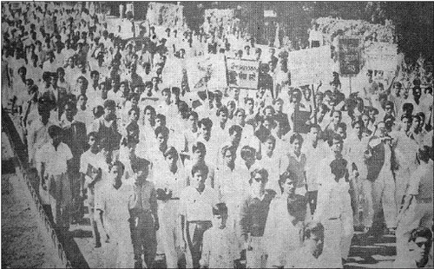
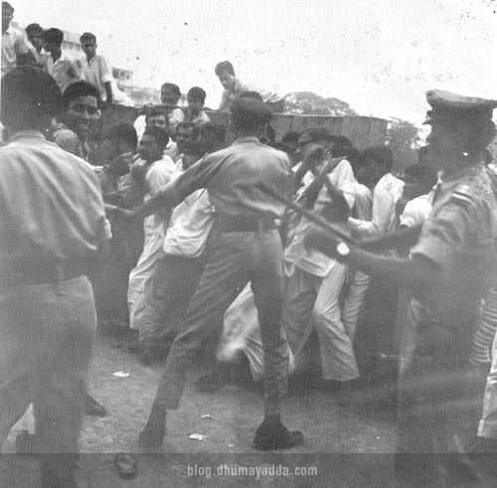
1962
Student Movement

Slide 9
1962
Student Movement

Slide 10
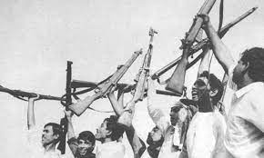
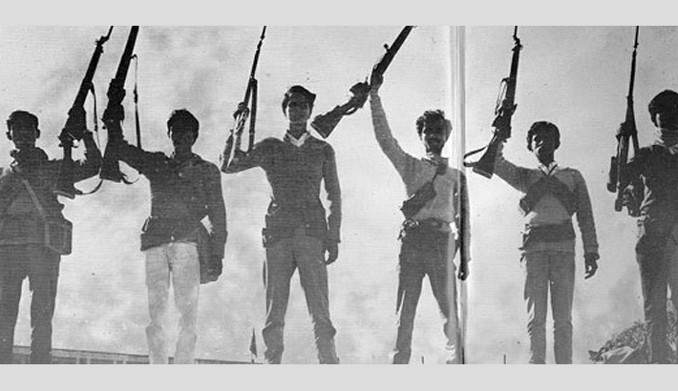
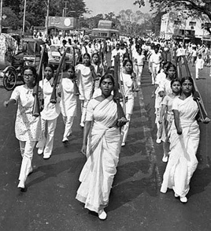
Libaration war of
1971

Slide 11
Libaration war of
1971

Slide 12


Thank you very much!

